Slide 1

User Analytics in the Telecommunication Industry Overview By Pavan Kumar

Slide 2
INDEX 1. Objective 2. Importing Dataset 3. Handling Missing Values.. 4. Handling Outliers. 5. Analysis On Data.. 6. Finding Total Data Received , Sent. 7. Applying KNN Method

Slide 3
Objective The investor is interested in purchasing TellCo, an existing mobile service provider in the Republic of Pefkakia. TellCo’s current owners have been willing to share their financial information but have never employed anyone to look at their system-generated data. To provide a report to analyze opportunities for growth and make a recommendation on whether TellCo is worth buying or selling.

Slide 4
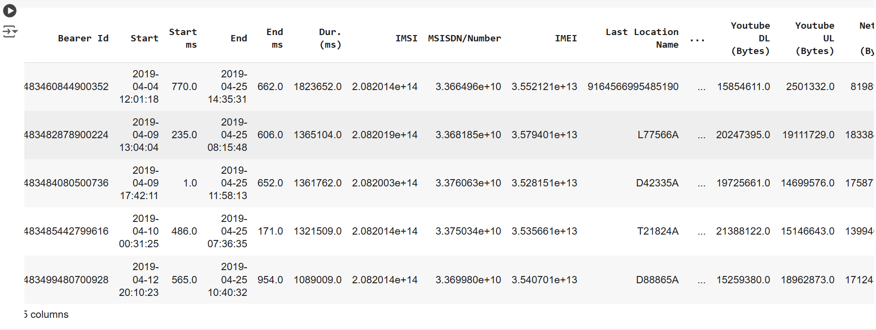
Importing Data Set: 1) Importing the Data Set: a) For Importing the Dataset we have First Imported the Pandas Data Frame and then we have used the below Code: import pandas as pd d1=pd.read_csv(r"E:\DIGI chrome\Data sets\Telcom Data.csv")

Slide 5
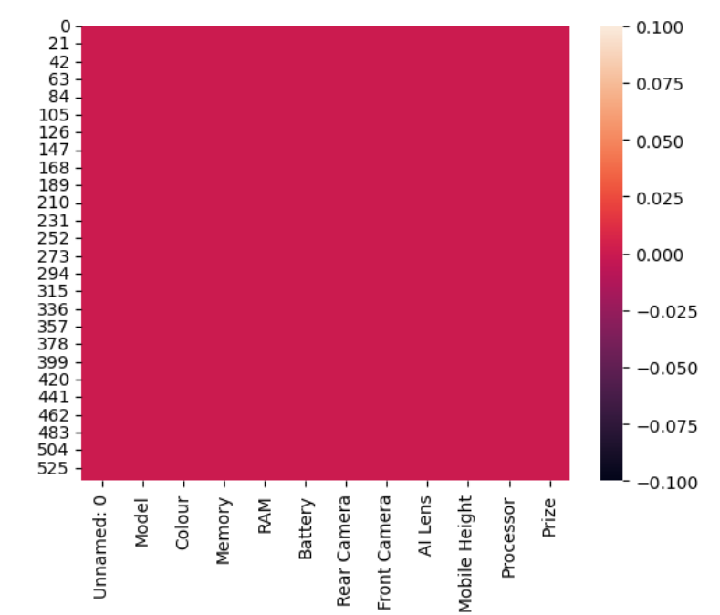
Handling Missing Values 1) Handling Missing Values : We have checked any missing values are present but there is no missing values. Import seaborn as sns sns.heatmap(d1.isnull()) 2) Duplicated data: And also we have checked any duplicates are there but there are no duplicates. d1.duplicated().any()

Slide 6
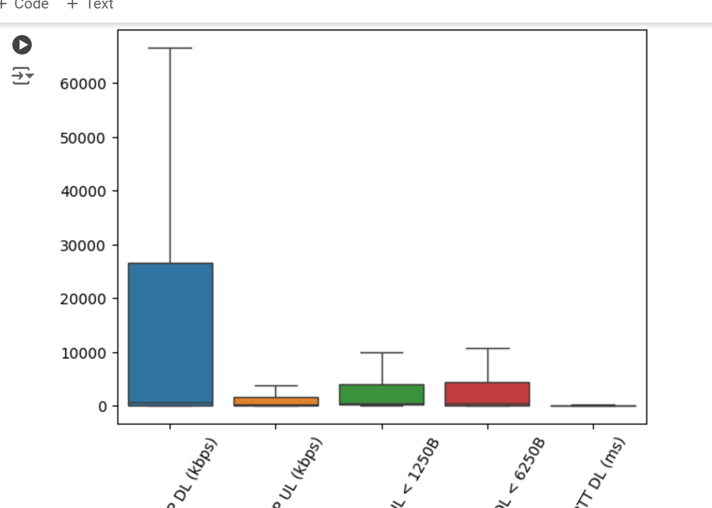
Handling Outliers 1) Handling Outliers: a) For handling the Outliers I have used the IQR Method , For that first we have to find the upper bond and lower bond and then we have update the values or delete the rows which has the value greater than upper bond and lower bond. For column like l'Avg Bearer TP DL (kbps)','Avg Bearer TP UL (kbps)','Nb of sec with Vol UL < 1250B','Nb of sec with Vol DL < 6250B','Avg RTT DL (ms)’ upper_limit = Q3 + (1.5 * IQR) lower_limit = Q1 - (1.5 * IQR) d1.loc[d1[x] > upper_limit, x] = upper_limit d1.loc[d1[x] < lower_limit, x] = lower_limit

Slide 7
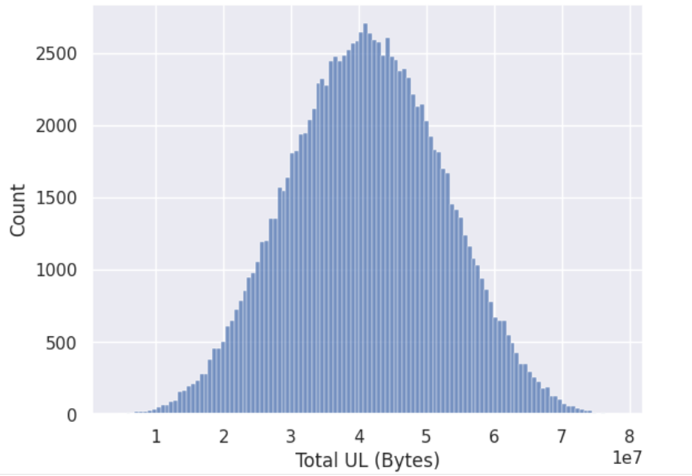
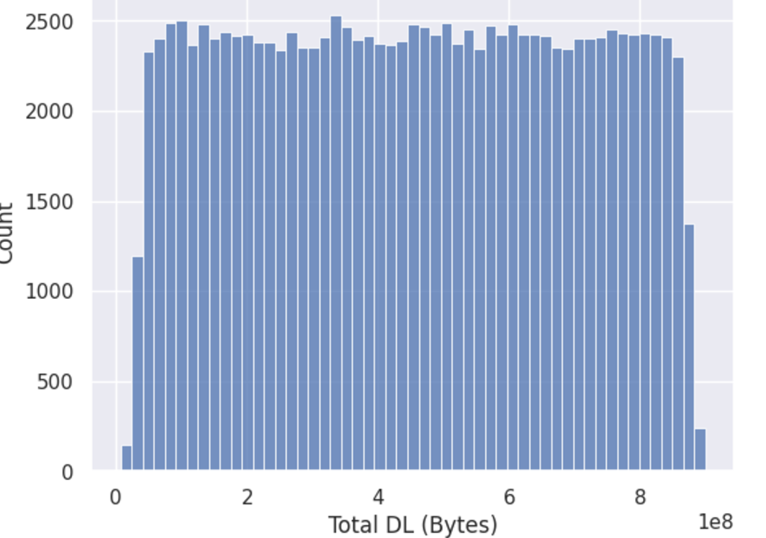
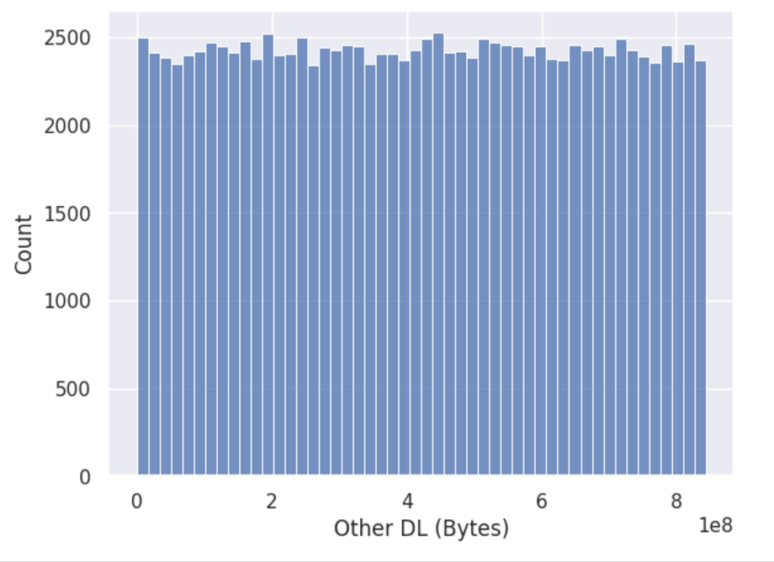
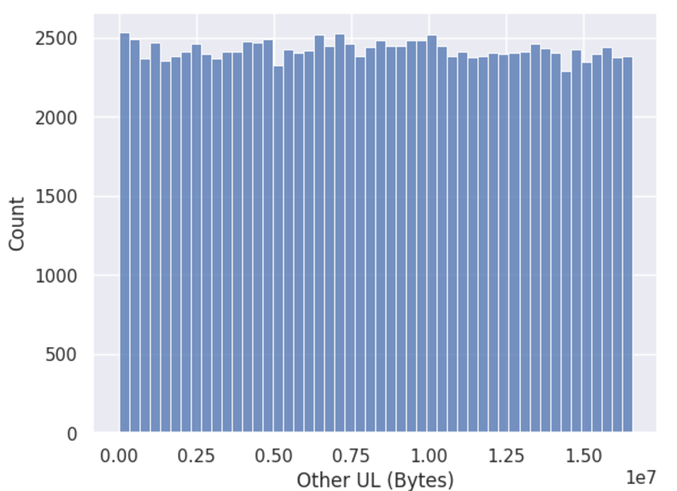
Analysis: We have done different types of analysis on different columns by seeing that we can say that for some columns the receiving data and sending data has been more but for some columns the receiving data is more than the sent data.

Slide 8
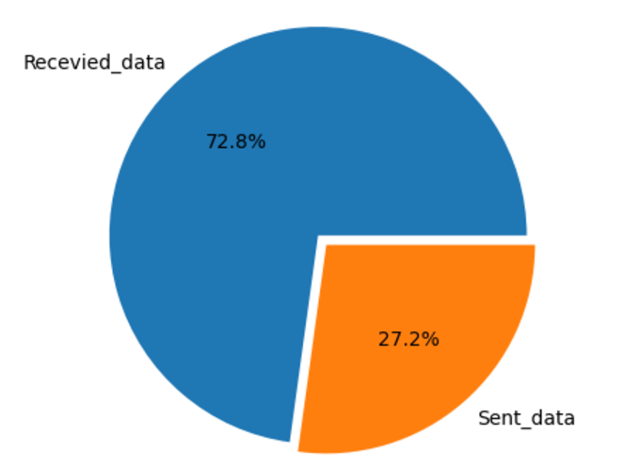
Total Data: After doing some analysis we have found that receiving data has been more than the sent data . For calculating the total data we have considered all the session and passthrough columns. For that we have used : labels=np.array(['Recevied_data','Sent_data']) explode=[0.03,0.03] plt.pie(x=[Total_recevied_data,total_sent_data],labels=labels,explode=explode,autopct='%1.1f%%') plt.show()

Slide 9
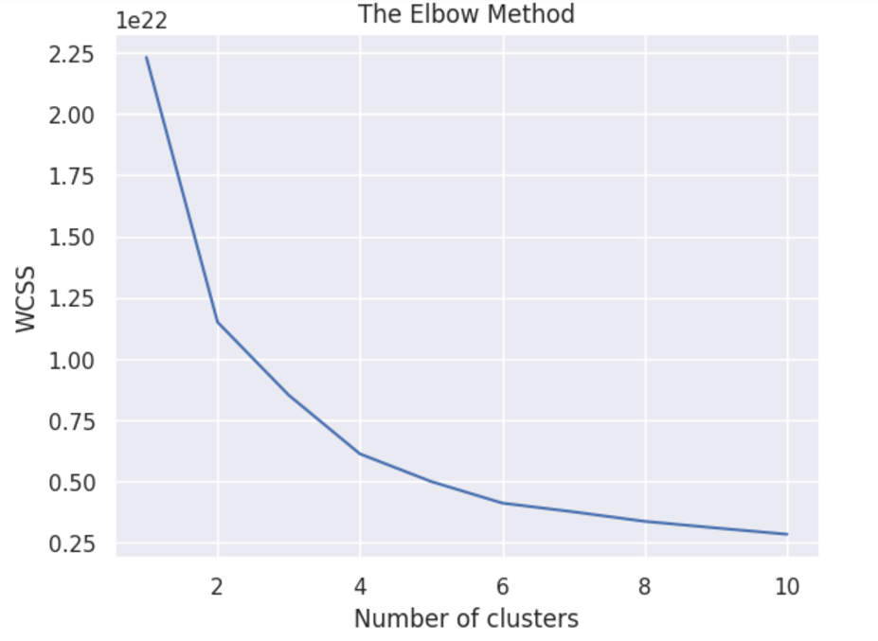
Elbow_Method : For this dataset we have applied the K-nearest neighbour algorithm for finding the k value we have been applied the elbow method by seeing the diagram we can say that k value is minimum at the value 6. And also we have tried the K-Nearest model with the value 3, so it form 3 clusters as well.

Slide 10
Thank You!

